Slide 1
supply chain
File created on: 23-09-2024 23:00:43

Slide 2
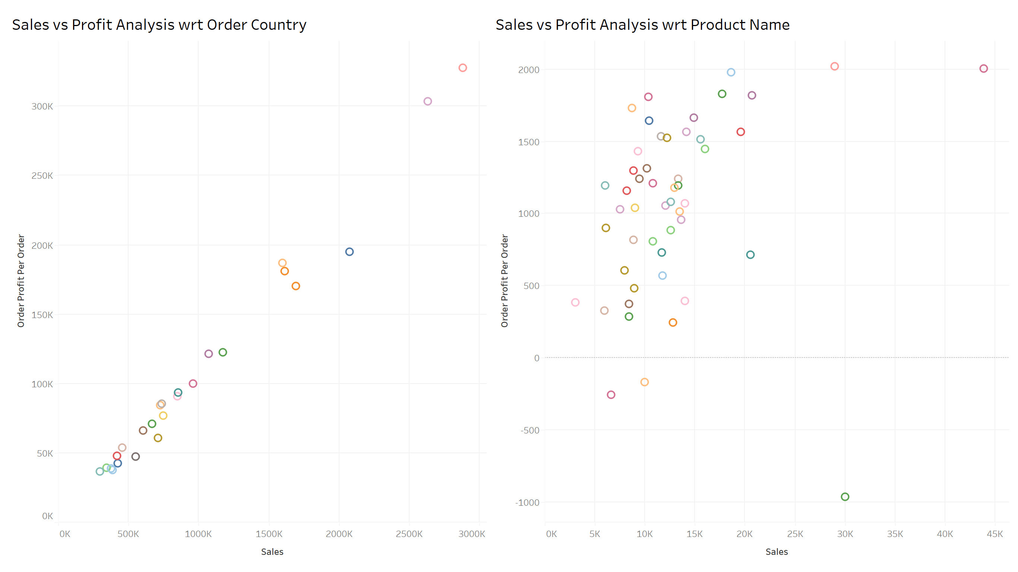

Slide 3
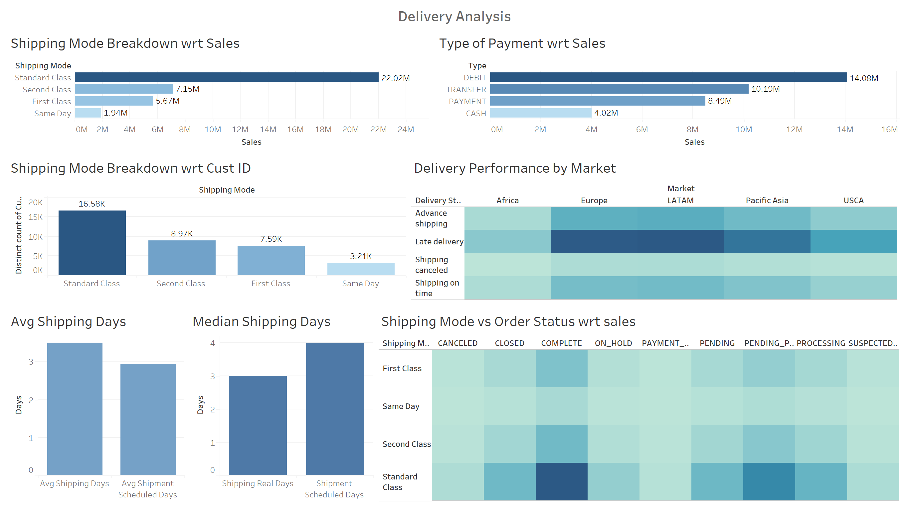

Slide 4
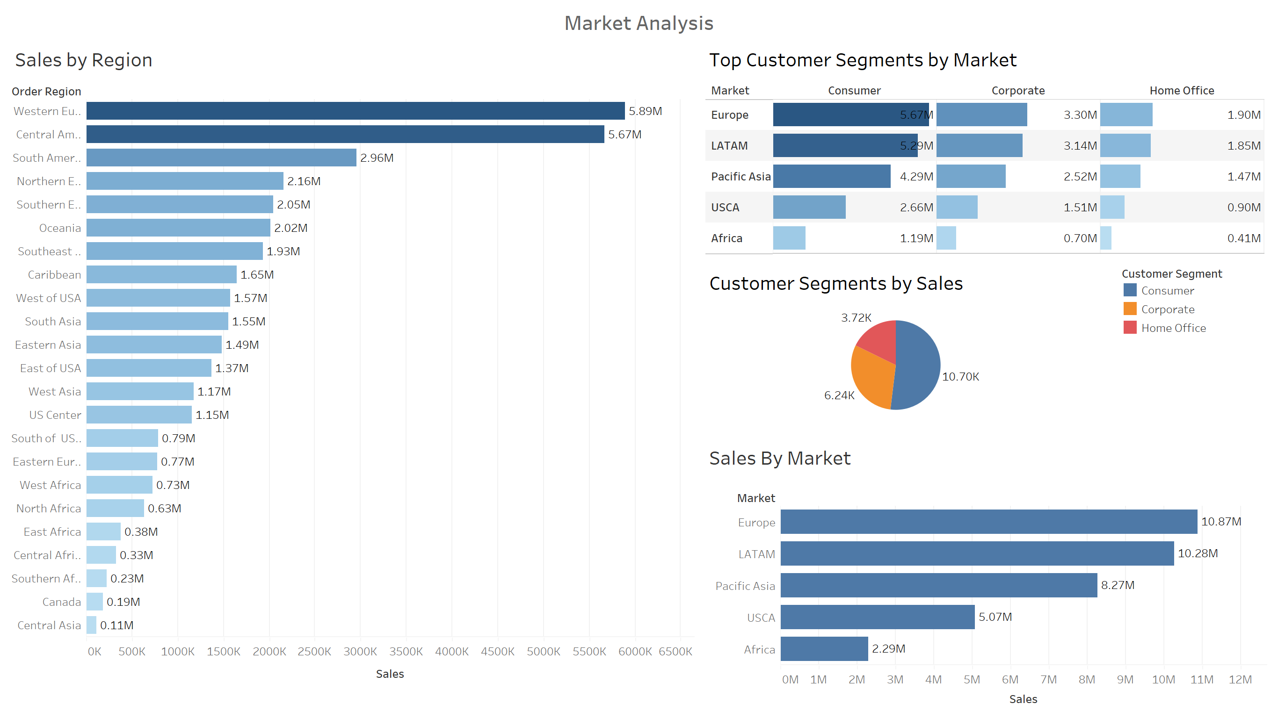

Slide 5
